Slide 1
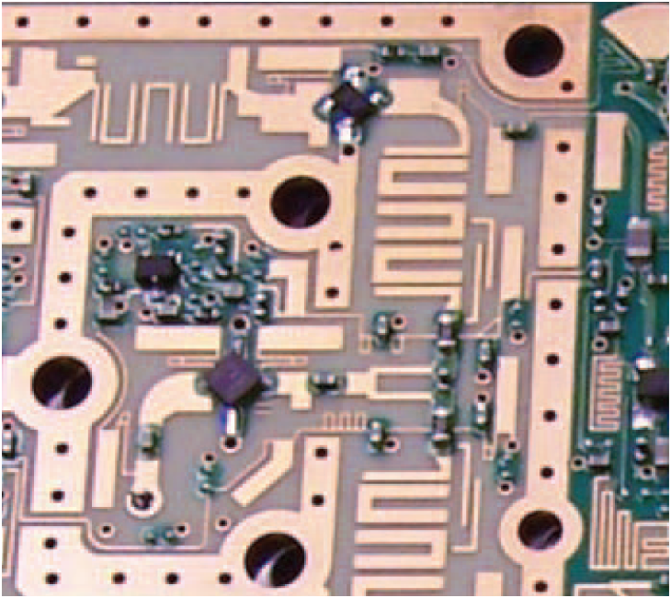
2. Transmission Lines
7e Applied EM by Ulaby and Ravaioli

Slide 2
Chapter 2 Overview

Slide 3
What are Transmission Lines
All structures and media that serve to transfer energy or information between two points, including nerve fibers in the human body and fluids and solids that support the propagation of mechanical pressure waves
We only focus on transmission lines that guide electromagnetic signals. Such transmission lines include telephone wires, coaxial cables carrying audio and video information to TV sets or digital data to computer monitors, microstrips printed on microwave circuit boards, and optical fibers carrying light waves for the transmission of data at very high rates

Slide 4
Transmission Line is Two-Port Network
A transmission line connects a generator to a load
Any circuit generating an output voltage
Radar transmitter
Amplifier
Computer terminal

Slide 5

Why Need Transmission Line Theory
The key difference between circuit theory and transmission line theory is electrical size
For traditional circuit theory, the physical dimension of the circuit is much smaller than the wavelength
For transmission line theory, the physical dimension of the circuit is a considerable fraction of a wavelength, or many wavelengths
Ordinary Circuit
λ
Lumped system V and I roughly do not vary
Transmission Line
Distributed system V and I vary in mag and phase
λ

Slide 6
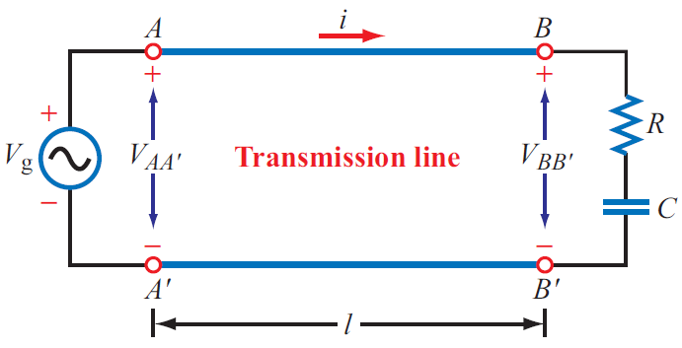
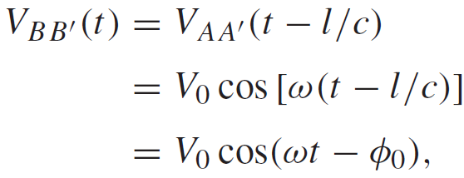
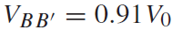
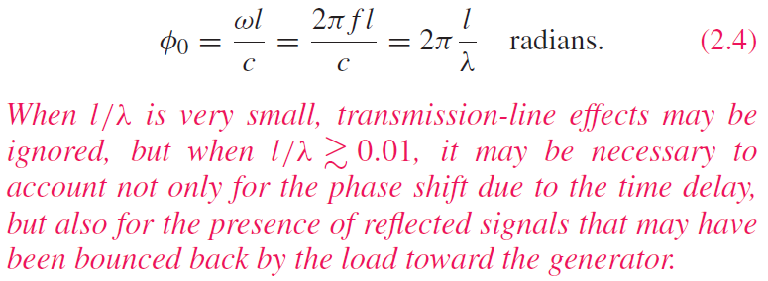
Transmission Line Effects
Is the pair of wires connecting the voltage source to the RC load a transmission line? Yes.
The wires were ignored in circuits courses. Can we always ignore them? Not always.
Delayed by l/c
(2) But if l = 20 km:
Telephone cable
At t = 0, and for f = 1 kHz , if:
(1) l = 5 cm:
λ = 300 km

Slide 7
Types of Transmission Modes
TEM Lines
This chapter
Non-TEM Lines

Slide 8
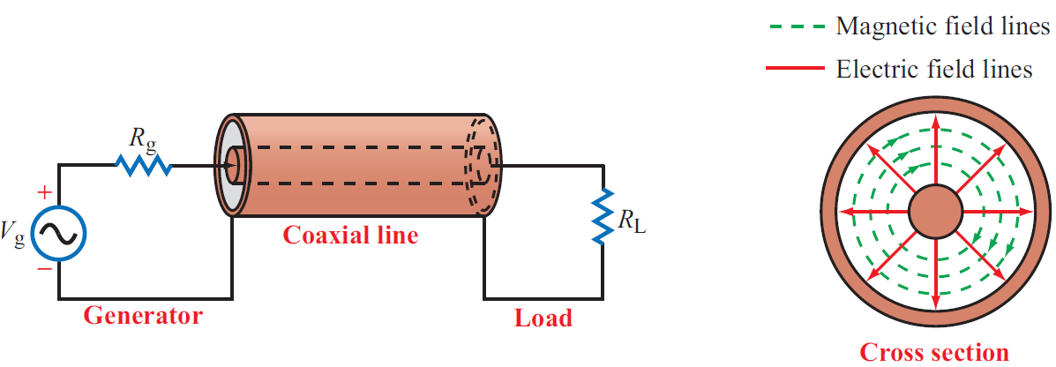
Example of TEM Mode: Coaxial
Magnitude and direction of E, H, V, I vary periodically in time and along the transmission line
Electric Field E is radial
Magnetic Field H is circular
Propagation is into the page

Slide 9
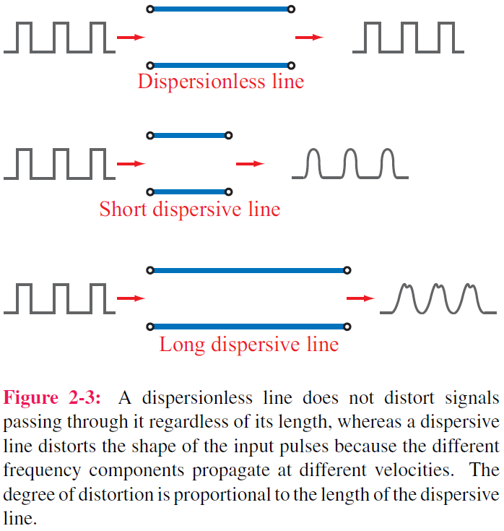
Dispersion in Transmission Lines
Dispersion/Distortion: Phase velocity vary with frequency
Nature of materials (material dispersion)
Non-TEM waveguides (structure dispersion)

Slide 10
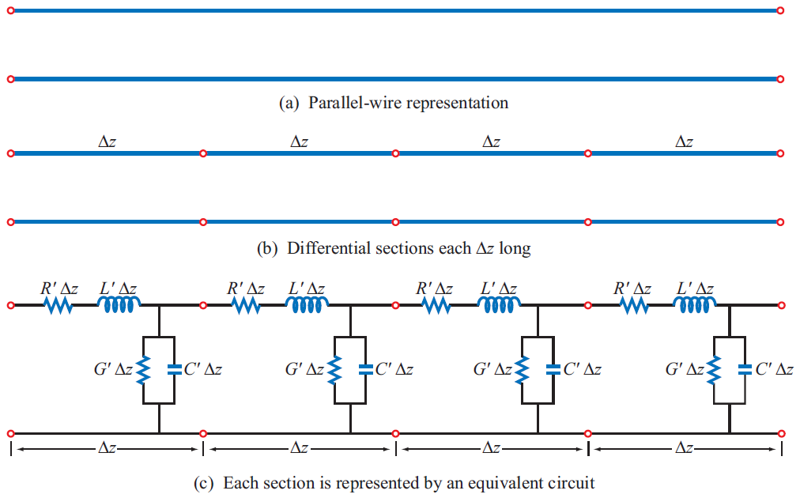
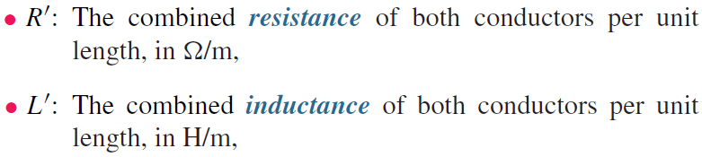
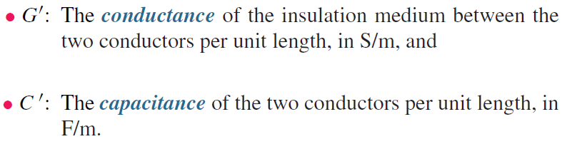
Transmission Line Model
Two thick wires
Lumped element model

Slide 11
Interpretation of Parameters
Ordinary Wire
L’ is the total self-inductance of the two conductors
C’ is the capacitance due to the close proximity of the two conductors
R’ is the resistance due to the finite conductivity of the individual conductors
G’ is conductance due to dielectric loss in the material between the conductors

Slide 12
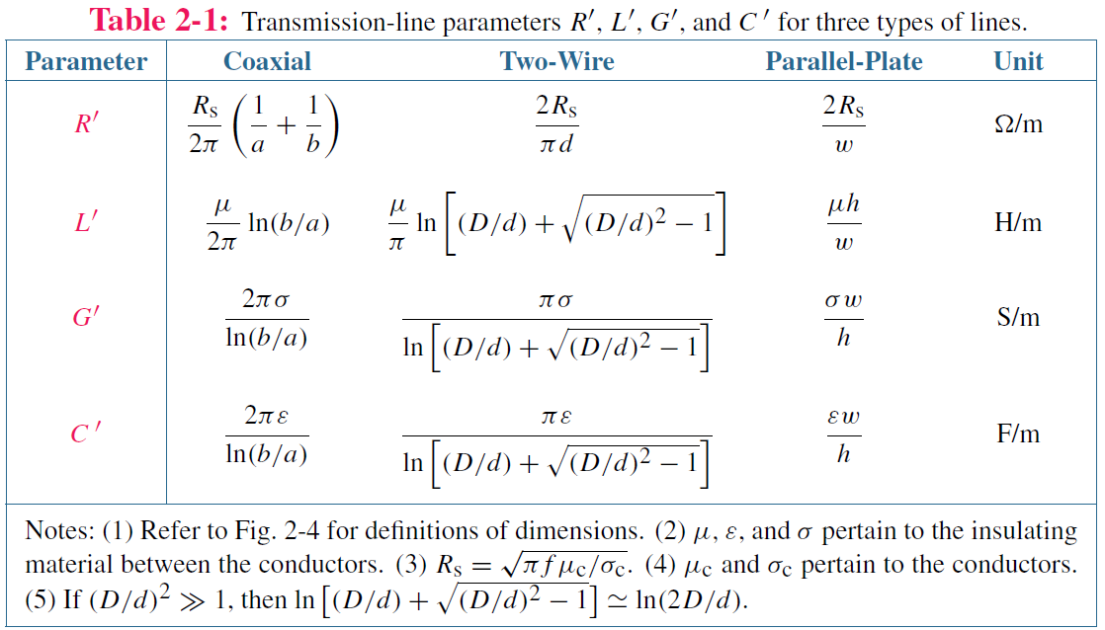
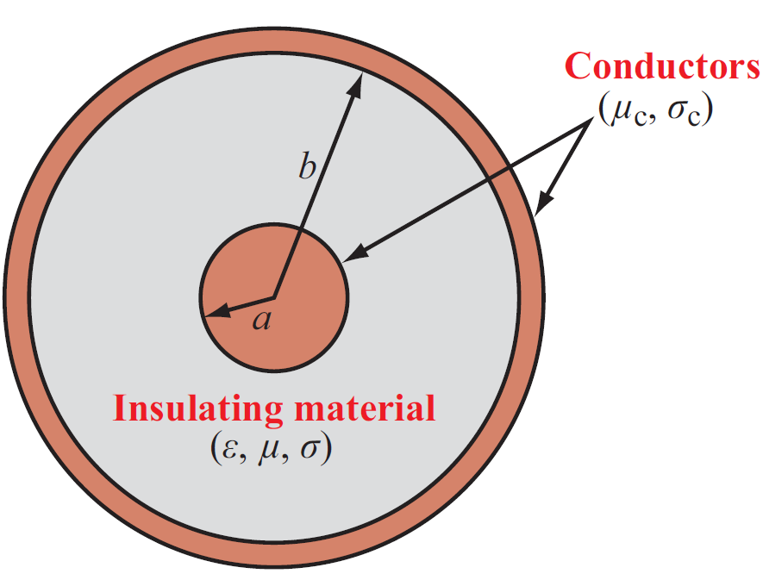
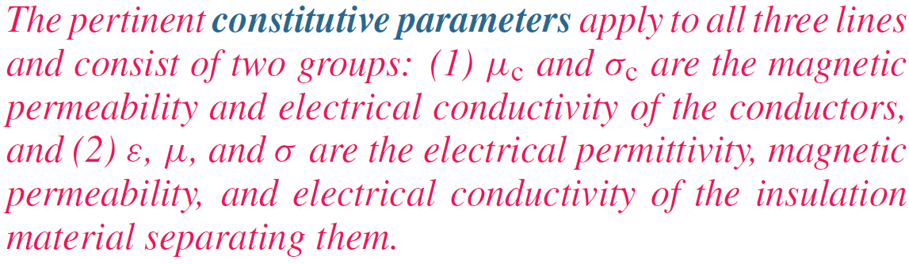
Expressions will be derived in later chapters

Slide 13
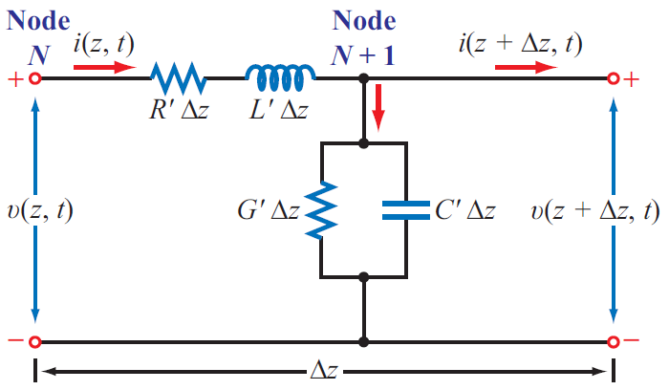
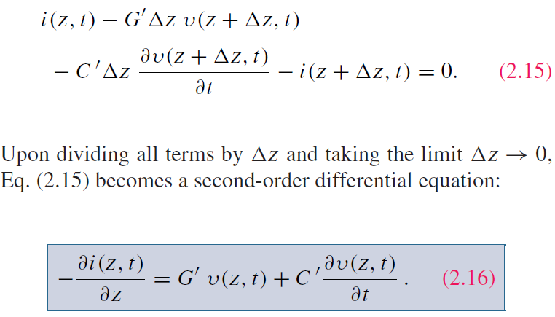
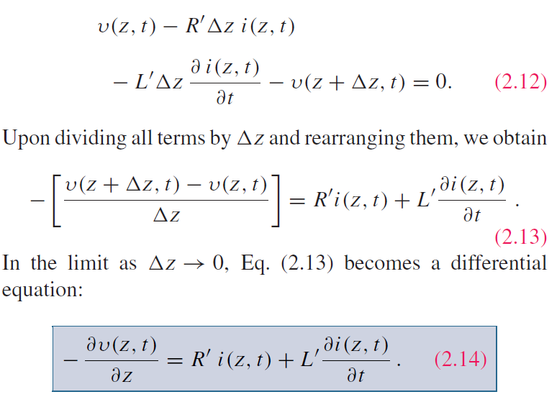
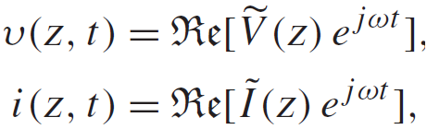
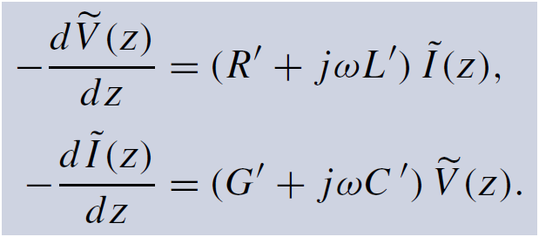
Transmission-Line Equations
ac signals: use phasors
Telegrapher’s equations

Slide 14
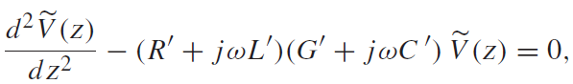
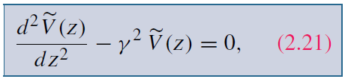
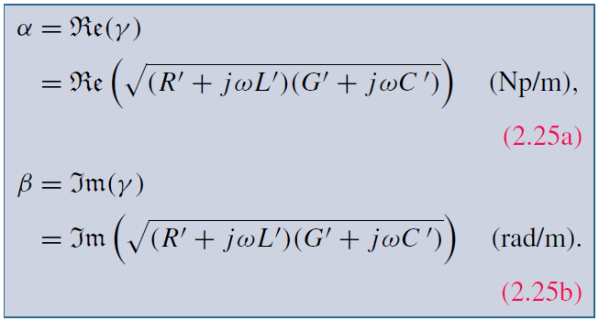
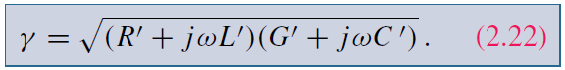
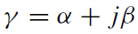
Derivation of Wave Equations
Combining the two equations leads to:
Second-order differential equation

Slide 15
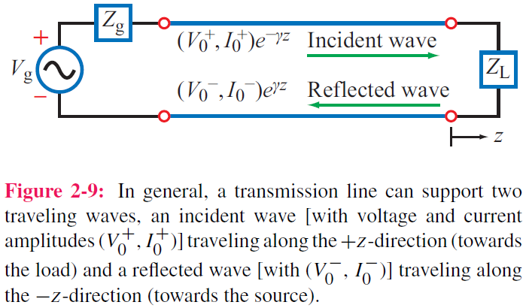
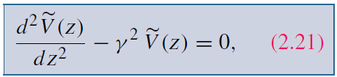
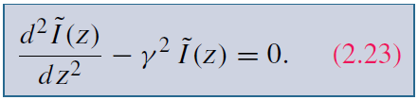
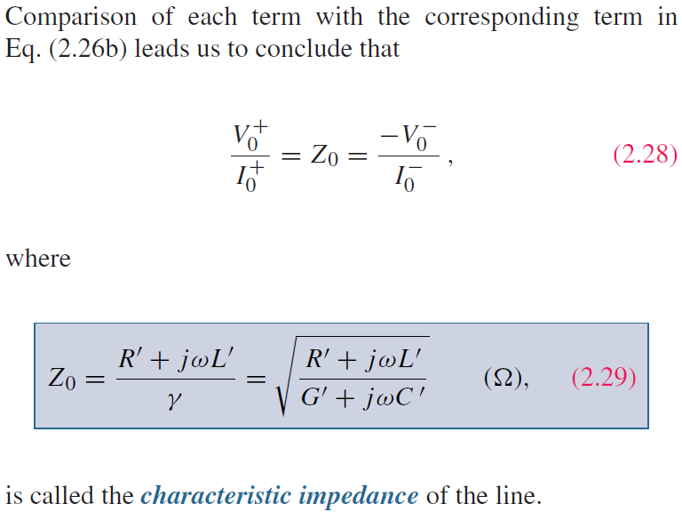
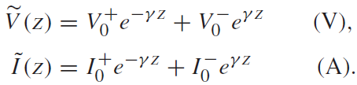
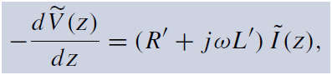
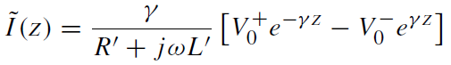
Solution of Wave Equations (cont.)
General solutions:
See p. 58
Using:
Determined by structure and material
It follows that:

Slide 16
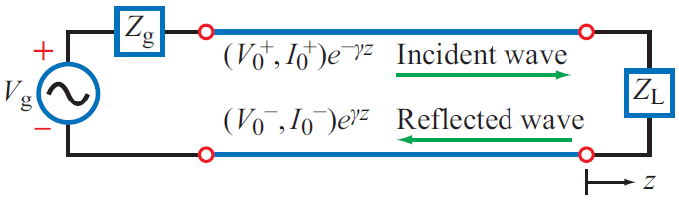
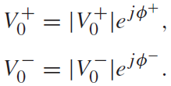
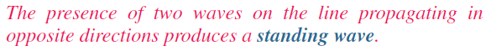
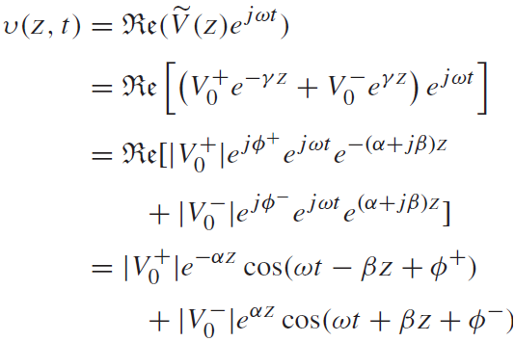
Solution of Wave Equations (cont.)
In general:
wave along +z
wave along –z

Slide 17
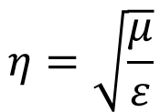
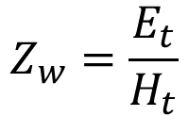
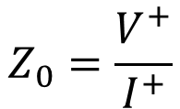
Summary of Impedance
So far we have learned three different concepts of impedance: wave impedance, intrinsic impedance and characteristic impedance
Wave Impedance
$$Z_{w}=\frac{E_{t}}{H_{t}}$$
Feature of particular type of wave
Wave
Intrinsic Impedance
$$η=\sqrt{\frac{μ}{ε}}$$
Depends on material parameters
Medium
Characteristic Impedance
Transmission Line
$$Z_{0}=\frac{V^{+}}{I^{+}}$$
Ratio of voltage to current on a TL
For TEM waves, the wave impedance is equal to the intrinsic impedance. For example, plane wave and waves in a coaxial cable

Slide 18
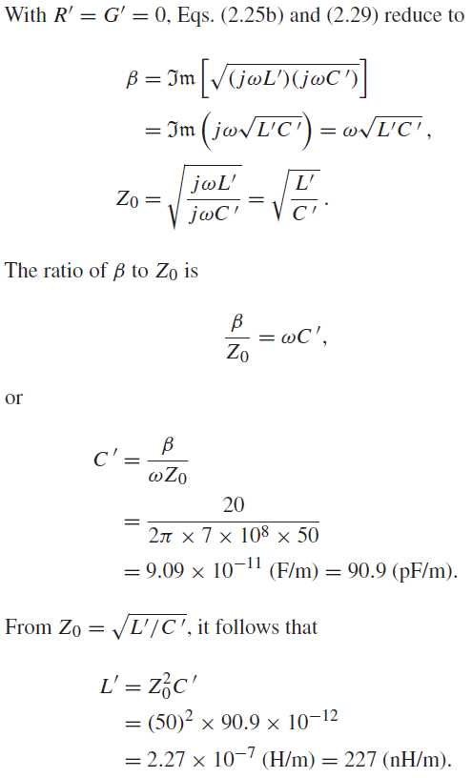
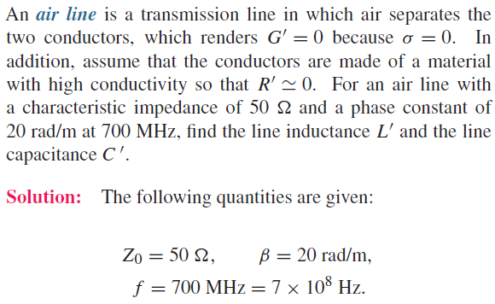
Example 2-1: Air Line

Slide 19
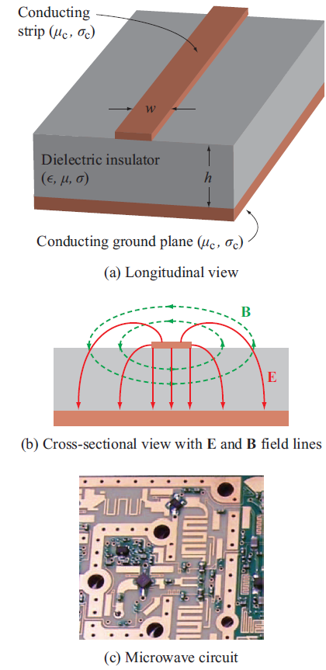
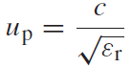
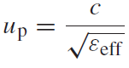
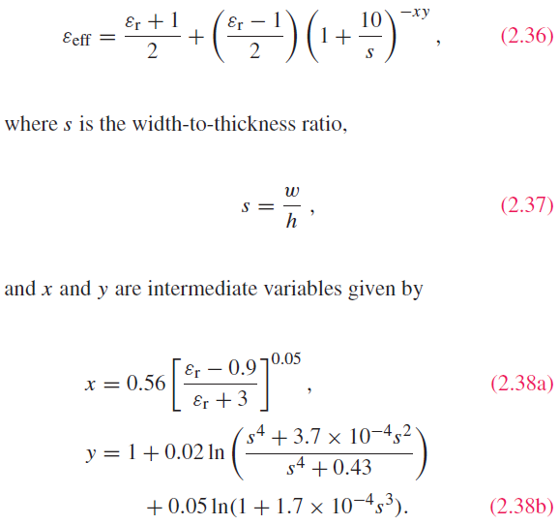
Lossless Microstrip Line
Phase velocity in dielectric:
Phase velocity for microstrip:
Quasi-TEM

Slide 20
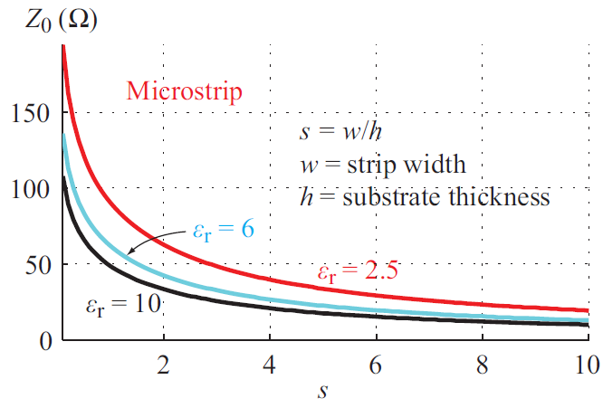
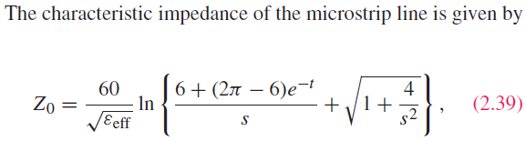
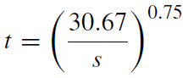
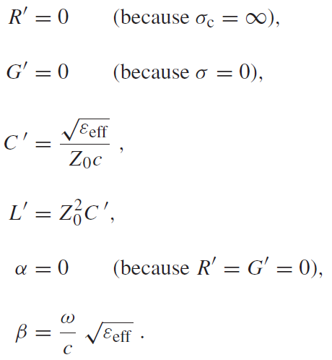
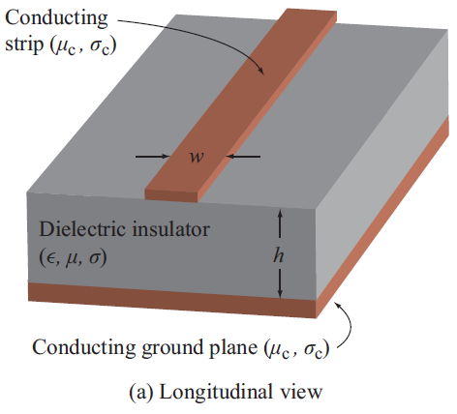
Microstrip (cont.)

Slide 21
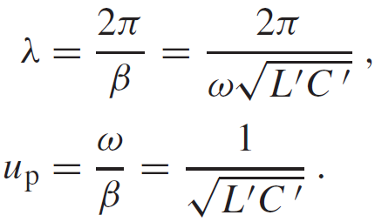
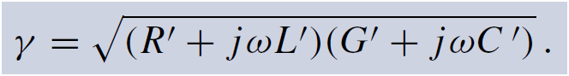





Lossless Transmission Line
If
Then:
TEM

Slide 22


Slide 23






Voltage Reflection Coefficient
At the load (z = 0):
Reflection coefficient
Normalized load impedance

Slide 24


Voltage Reflection Coefficient

Slide 25

Current Reflection Coefficient

Slide 26




Slide 27




Standing Waves
voltage magnitude
current magnitude

Slide 28
Standing-Wave Pattern
When voltage is a maximum, current is a minimum, and vice versa

Slide 29



Standing Wave Patterns for 3 Types of Loads

Slide 30


Maxima & Minima
Standing-Wave Pattern

Slide 31


Maxima & Minima (cont.)
Voltage Standing Wave Ratio
$$SWR=\frac{{\left|\overset{⃑}{V}\right|}_{max}}{{\left|\overset{⃑}{V}\right|}_{min}}=\frac{1+\left|Γ\right|}{1−\left|Γ\right|}$$
For a matched load: S = 1
For a short, open, or purely reactive load:

Slide 32




Example 2-6: Measuring Z_{L} with a Slotted Line
See p. 74

Slide 33



Wave Impedance
At a distance d from the load:

Slide 34




Input Impedance
At input, d = l:
See p. 76

Slide 35



Cont.

Slide 36


(cont.)
Cont.

Slide 37



(cont.)

Slide 38




Short-Circuited Line
For the short-circuited line:
At its input, the line appears like an inductor or a capacitor depending on the sign of

Slide 39





Slide 40


Open-Circuited Line

Slide 41



Short-Circuit/Open-Circuit Method
For a line of known length l, measurements of its input impedance, one when terminated in a short and another when terminated in an open, can be used to find its characteristic impedance Z₀ and electrical length

Slide 42

Half Wavelength Line
$$\tan{βl}=\tan{\frac{2π}{λ}\frac{λ}{2}}=0$$
So adding a half-wavelength transmission line does not change the load impedance
l
l+λ/2
Z₀
Z_{L}
Z₀
Z_{L}
Z_{in}
Z_{in}

Slide 43

Quarter Wavelength Line
$$\tan{βl}=\tan{\frac{2π}{λ}\frac{λ}{4}}=∞$$
So adding a quarter-wavelength transmission line transforms the load impedance in an inverse manner
Useful in impedance matching since the reflection coefficient is 0

Slide 44
Terminated by Another TL
Infinitely long or matched
Z₁
Insertion loss (IL)

Slide 45




Slide 46


Slide 47



Instantaneous Power Flow

Slide 48



Average Power

Slide 49

The Smith Chart
Developed in 1939 by P. W. Smith as a graphical tool to analyze and design transmission-line circuits
Today, it is used to characterize the performance of microwave circuits

Slide 50




Complex Γ Plane
Γ = 0
Matching Point

Slide 51

Constant SWR Circles
|Γ| = 1
Im (Γ_{i})
$$SWR=\frac{1+\left|Γ\right|}{1−\left|Γ\right|}$$
|Γ| = 0.75
|Γ| = 0.5
A circle with a radius of |Γ| is called SWR circle, since |Γ| is constant on this circle
|Γ| = 0.25
Re (Γ_{r})
SWR = 1.67
SWR = 3
SWR = 7
SWR = ∞

Slide 52







Smith Chart Parametric Equations
The most usefulness of the Smith chart is converting from reflection coefficient Γ to normalized impedance z_{L}
Equation for a circle
$r_{L}$ is constant on a specific circle
$x_{L}$ is constant on a specific circle

Slide 53






Resistance (r_{L}) Circles
Circles in the (Γ_{r}, Γ_{i}) plane centered at ($\frac{r_{L}}{1+r_{L}}$,0) with a radius of $\frac{1}{1+r_{L}}$ and all pass through the point Γ = 1
$$r_{L}=0$$
centered at (0,0), radius is 1
the Big circle
$r_{L}$ small
$r_{L}$ big
As $r_{L}$ increases, the center moves to the right and radius becomes smaller
o.c.
$$r_{L}=∞$$
centered at (1,0), radius is 0
a point at (1,0)

Slide 54





Examples
$$r_{L}=0.2$$
$$r_{L}=0.5$$
$$r_{L}=1$$
$$r_{L}=2$$
$$r_{L}=5$$
r_{L} circles are contained inside the unit circle

Slide 55







Reactance (x_{L}) Circles (Inductive)
Circles in the (Γ_{r}, Γ_{i}) plane centered at ($1$, $\frac{1}{x_{L}}$) with a radius of $\frac{1}{x_{L}}$
and all pass through the point Γ = 1
$x_{L}>0$ inductive
+$x_{L}$ small
$$x_{L}=0$$
centered at (1,∞), radius is ∞ the horizontal line
+$x_{L}$ big
As $x_{L}$ increases, the center moves down and radius becomes smaller
$$x_{L}=∞$$
centered at (1,0), radius is 0
a point at (1,0)

Slide 56






Reactance (x_{L}) Circles (Capacitive)
Circles in the (Γ_{r}, Γ_{i}) plane centered at ($1$, $\frac{1}{x_{L}}$) with a radius of $\frac{1}{x_{L}}$
and all pass through the point Γ = 1
$x_{L}<0$ capacitive
$$x_{L}=0$$
centered at (1,∞), radius is ∞, the horizontal line
As $x_{L}$ decreases, the center moves down and radius becomes smaller
$−x_{L}$ big
$$x_{L}=−∞$$
centered at (1,0), radius is 0
a point at (1,0)
$−x_{L}$ small

Slide 57






Examples
$$x_{L}=0.5$$
$$x_{L}=1$$
$$x_{L}=2$$
Only parts of the x_{L} circles are contained within the unit circle
$$x_{L}=−2$$
$$x_{L}=−0.5$$
$$x_{L}=−1$$

Slide 58

r_{L} and x_{L} Circles
Given Γ = Γ_{r} + jΓ_{i}, z_{L} = r_{L} + jx_{L} can be determined and vice versa
Every point in the Smith chart corresponds to a Γ and z_{L}
s.c.
When use the Smith chart to solve problems, Z₀ is known and fixed

Slide 59
Complete Smith Chart
Positive xL Circles
rL Circles
Negative xL Circles

Slide 60



Determine Input Impedance
l
Γe^{−2jβl}
$$Γe^{−2jβl}=\frac{Z_{in}−Z_{0}}{Z_{in}+Z_{0}}$$
Z₀
Z₀
Z_{L}
Z_{in}
Γ
$$z_{in}=\frac{1+Γe^{−2jβl}}{1−Γe^{−2jβl}}$$
$$z_{L}=\frac{1+Γ}{1−Γ}$$
Same form
Normalized input impedance

Slide 61



Determine Input Impedance (cont.)
$$z_{in}=\frac{1+Γe^{−2jβl}}{1−Γe^{−2jβl}}$$
$$z_{L}=\frac{1+Γ}{1−Γ}$$
Same form
Im (Γ_{i})
$$l=\frac{λ}{2} ⇒ 2βl=2π$$
Γ, z_{L}
Rotating clockwise for one circle means adding a λ/2 line
2βl
Re (Γ_{r})
If z_{in} is given, do a rotation counter-clockwise for an angle of 2βl will find the z_{L} point
Γe^{−2jβl}, z_{in}

Slide 62





A Simple Way to Get SWR
SWR can be obtained by drawing a SWR circle and get the intersection at the negative horizontal axis. Then read the SWR scale below the Smith chart
There is another simple way to get SWR
For a real load
$$Γ=\frac{r_{L}−1}{r_{L}+1}$$
$$r_{L}=\frac{1+Γ}{1−Γ}$$
Same
$$SWR=\frac{1+\left|Γ\right|}{1−\left|Γ\right|}$$
$$for r_{L}>1 SWR=\frac{1+Γ}{1−Γ}$$
$$When r_{L}>1 SWR=r_{L}$$
So SWR can also be obtained by drawing a SWR circle and read the resistor value of the intersection at the positive horizontal axis

Slide 63



V_{max} and V_{min} Point
The locations with maximum voltage (V_{max}) and minimum voltage (V_{min}), which can also be found in the Smith chart
The length of transmission line from the load to the first V_{max} point and the first V_{min} point can be found by the SWR circle
$$\max{Γe^{−2jβl}} real>0$$
$$\left|V\right|=\left|V_{0}^{+}\right|\left|1+Γe^{−2jβl}\right|$$
$$\min{Γe^{−2jβl}} real<0$$
2βl_{max}
2βl_{max}
2βl_{min}
2βl_{min}

Slide 64
Summary of Special Points and lines
Short Circuit (Γ = −1)
Open Circuit (Γ = 1)
Matching Point (Γ = 0)
Pure Reactance Circle (|Γ| = 1, r_{L} = 0)
Pure Resistance Line (Γ real)
V_{min} Line
V_{max} Line

Slide 65
Summary of Scales
Γ Angle
TL Length
Inductor
Resistor
SWR
Capacitor

Slide 66
General Steps
θ
x_{L}
z_{L}
Γ
|Γ|
2βl
r_{L}
z_{in}

Slide 67



Example
A load impedance 40 + 70j Ω terminates a 100 Ω transmission line that is 0.3 λ long. Find the reflection coefficient at the load, the reflection coefficient at the input to the line, the input impedance, the standing wave ratio on the line, and the return loss
0.106 λ
$$∠Γ=104°$$
$$∠Γ_{in}=248°$$
$$z_{in}=0.365−0.611j$$
0.406 λ

Slide 68






(c)
(d)
(a)
(b)

Slide 69




Given:
S = 3
Z₀ = 50 Ω
first voltage min @ 5 cm from load
Distance between adjacent minima = 20 cm
Determine: Z_{L}

Slide 70









Determine Admittance from Impedance
The Smith chart can be used to find normalized admittance in a simple way
$$l=\frac{λ}{4} Z_{in}=\frac{Z_{0}^{2}}{Z_{L}} z_{in}=\frac{1}{z_{L}}$$
$$y_{L}=\frac{1}{z_{L}}$$
$$⇒ y_{L}=z_{in}$$
Numerically
$$z_{L}$$
Rotate z_{L} by half circle and read the impedance value to get y_{L}
$$Y_{L}=\frac{y_{L}}{Z_{0}}$$
$$Γ=\frac{z_{L}−1}{z_{L}+1}$$
$$Γ=\frac{\frac{1}{y_{L}}−1}{\frac{1}{y_{L}}+1}=\frac{1−y_{L}}{1+y_{L}}=\frac{−\left(y_{L}−1\right)}{y_{L}+1}$$
$$y_{L}$$
$$−Γ=\frac{y_{L}−1}{y_{L}+1}$$

Slide 71








Admittance Circles (g_{L} and b_{L})
$$Γ=\frac{1−y_{L}}{1+y_{L}}$$
$$y_{L}=\frac{1−Γ}{1+Γ}$$
$$g_{L}+jb_{L}=\frac{\left(1−Γ_{r}\right)−jΓ_{i}}{\left(1+Γ_{r}\right)+jΓ_{i}}$$
$$y_{L}=g_{L}+jb_{L}$$
$$g_{L}=\frac{1−Γ_{r}^{2}−Γ_{i}^{2}}{{\left(1+Γ_{r}\right)}^{2}+Γ_{i}^{2}}$$
$${\left(Γ_{r}+\frac{g_{L}}{1+g_{L}}\right)}^{2}+Γ_{i}^{2}={\left(\frac{1}{1+g_{L}}\right)}^{2}$$
$$b_{L}=\frac{−2Γ_{i}}{{\left(1+Γ_{r}\right)}^{2}+Γ_{i}^{2}}$$

Slide 72


Impedance and Admittance Calculation
Z0 can be arbitrary
z_{L}
z_{L}
R
z_{in}
Z_{L}
R
Z_{L}
y_{in}
y_{L}
z_{in}
z_{L}
L
Z_{L}
y_{in}
L
Z_{L}
z_{L}
y_{L}
z_{L}
z_{L}
C
Z_{L}
z_{in}
C
Z_{L}
y_{L}

Slide 73



Impedance Matching
$$Z_{in}=Z_{0}$$

Slide 74
Matching Network
The network has to transform the real part of the load impedance from R_{L} (at the load) to Z₀ at MM’ in the figure and transform the reactive part from X_{L} (at the load) to zero at MM’
To achieve these two transformations, the matching network must have at least two degrees of freedom, which means two adjustable parameters

Slide 75
Benefits of Matching
Assume the generator is matched, matching the load can enable maximum power delivered to the load
Can improve signal-to-noise ratio of impedance matching sensitive components, such as antenna and low-noise amplifier
In a power distribution network such as an antenna array feed network, matching can reduce amplitude and phase errors

Slide 76
Important Design Factors
Complexity The simplest design that satisfies the required specifications is generally preferable. A simpler matching network is usually cheaper, smaller, more reliable, and less lossy than a more complex design
Bandwidth Any type of matching network can ideally give a perfect match at a single frequency. But it is desirable to match a load over a band of frequencies
Implementation Depending on the type of transmission line or waveguide being used, one type of matching network may be preferable to another
Adjustability In some applications the matching network may require adjustment to match a variable load impedance

Slide 77
Possibility of Matching
So long as the load impedance Z_{L} has a positive real part, a matching network can always be found

Slide 78


Examples of Matching Networks

Slide 79
Lumped-Element Matching
This type of matching technique uses lumped elements, like inductors and capacitors. Transmission lines can also be used
No resistors are used because of the loss they will induce

Slide 80
L-section
L-section is the simplest type of matching network, which uses two reactive elements to match an arbitrary load impedance to a transmission line
Two possible configurations are shown below
z_{L} inside the grey region
z_{L} inside the grey region
What about z_{L} is on the 1 + jx circle?

Slide 81
Cont.
The jX and jB can be either inductors or capacitors
So there are in total eight possibilities for the L-section matching network
If the frequency is low enough and/or the circuit size is small enough, actual lumped-element capacitors and inductors can be used. This may be feasible for frequencies up to about 1 GHz. But in a large range of frequencies and circuit sizes, lumped elements may not be realizable. This is a limitation of the L-section matching network

Slide 82
Analytical Solutions (First Kind)
Impedance-matching condition requires
Separating into real and imaginary parts gives
The solutions are
Two possible solutions Positive X is an inductor and negative X is a capacitor Positive B is a capacitor and negative B is an inductor

Slide 83
Analytical Solutions (Second Kind)
Impedance-matching condition requires
Separating into real and imaginary parts gives
The solutions are
Still two possible solutions

Slide 84
Smith Chart Solution (First Kind)
y₁
z₁, y₁
Get y_{L} from z_{L}
Rotate on a constant r circle (here also viewed as a constant g circle) to arrive at y₁ on the symmetry of the r = 1 circle
Convert back to z₁, which will be on the r = 1 circle
Rotate on the r = 1 circle to the matching point
jb
y_{L}
z_{L}
jx
z₁
Two possible solutions

Slide 85
Smith Chart Solution (Second Kind)
z_{L}
jx
z₁
Rotate on a constant r circle to arrive at z₁ on the symmetry of the r = 1 circle
Convert to y₁, which will be on the r = 1 circle (here also viewed as the g = 1 circle)
Rotate on the r = 1 circle to the matching point
jb
y₁
Two possible solutions

Slide 86




Lumped-Element Matching with T-Lines
Choose d and Ys to achieve a match at MM’

Slide 87







Slide 88

Cont.

Slide 89


Single-Stub Matching
Replace the shunt element by a piece of short- or open-circuited transmission line

Slide 90





Slide 91


Transients
Rectangular pulse is equivalent to the sum of two step functions

Slide 92




Transient Response
Initial current and voltage
Reflection at the load
Load reflection coefficient
Second transient
Generator reflection coefficient

Slide 93


Voltage Wave
T = l/u_{p} is the time it takes the wave to travel the full length of the line

Slide 94


Current Wave
Reflection coefficient for current is the negative of that for voltage

Slide 95



Steady State Response

Slide 96



Bounce Diagrams

Slide 97





Slide 98

Technology Brief 4: EM Cancer Zapper

Slide 99

Technology Brief 4: High Voltage Pulses

Slide 100


Summary

